Slide 1


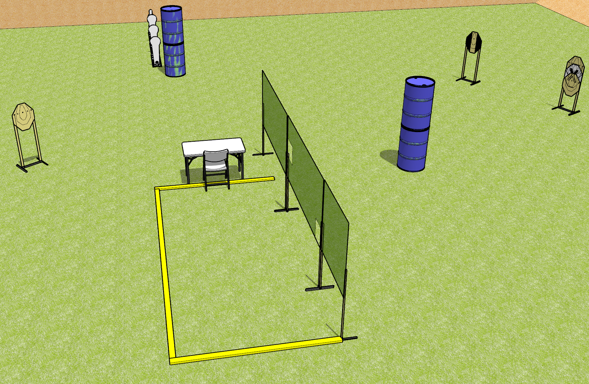
 | Dothan Gun Club – USPSA Match Have a Seat Over There Course Designer : Drew Coleman
Round Count 12 rounds 4 ISPC 3 colt poppers, 1 mini
Equipment List 4 wall feet Use 4 8’ fault lines 1 tuxedo

Slide 2
Have a Seat Over There
Written Stage Briefing
Have a Seat Over There is a 12 round, 60 point, Comstock course of fire. There are 4 IPSC targets, 3 colt poppers, and 1 mini popper. The best 2 hits on paper will score and steel must fall to score. The start signal is audible.
Start position is seated in chair, back against chair back, hands on knees. Firearm is unloaded and unpropped on the table. All magazines to be used on stage must also be on table.
Do not have to place gun or mags on marks, if table has marks.
On start signal, engage targets as they become available from within the shooting area.

